Slide 1
PILGRIMS OF HOPE:
MIGRANT SPIRITUALITY AND MISSION TODAY
Gemma Tulud Cruz, Ph.D
Gemma.Cruz@acu.edu.au

Slide 2
PRESENTATION OUTLINE
Introduction
Characteristics of Migrant Spirituality
  Courageous Hope
  Creative Resistance
  Steadfast Faith
  Festive Community Spirit
Facets of Mission Today
  Mission among the ‘Crucified People’
  Mission as Pilgrimage in the Wilderness
  Mission as a Consistent Ethic of Hope and Life
Conclusion

Slide 3
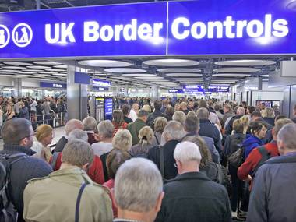
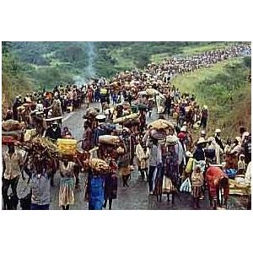
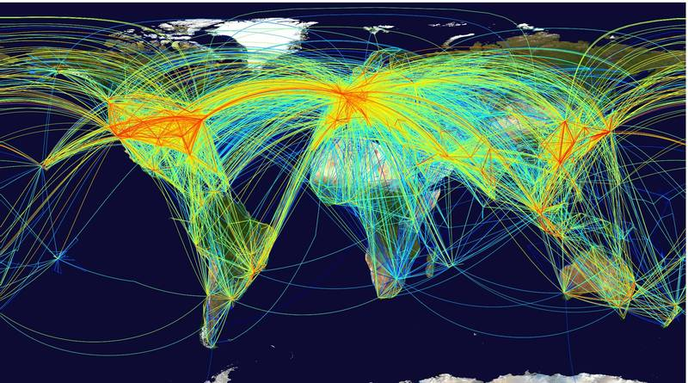
THE AGE OF MIGRATION
More than 200 million migrants worldwide
One out of every 33 persons in the world today is a migrant
Number of migrants could rise to as much as 405 million by 2050
Notes:
Today, one in thirty-three persons is a migrant and about 3% of the world’s population is comprised of migrants. While the percentage may seem miniscule it actually represents a lot of people.
Singapore: In 2000, 8% of the country's 4 million residents were foreigners. In 2012 foreigners made up 14% of its 5.3 million people.
Countries with the largest Christian populations and the deepest Christian roots host the fewest refugees.
The three regions which are host to the largest number of refugees around the world are:
Africa*: 2.2 million
Asia and Pacific: 4 million
Middle East and North Africa: 1.9 million

Slide 4
CHARACTERISTICS OF
MIGRANT SPIRITUALITY

Slide 5
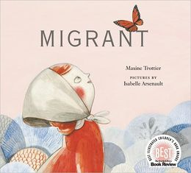
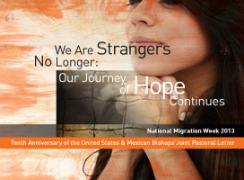
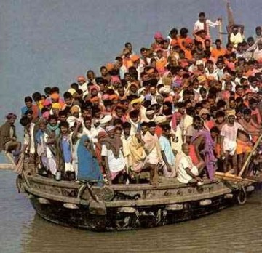
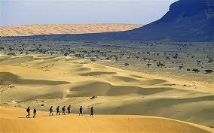
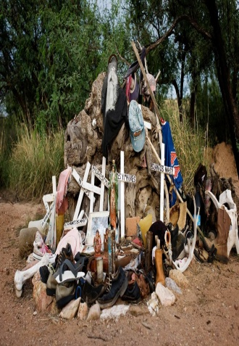
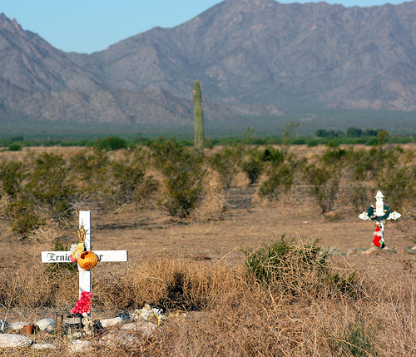
COURAGEOUS HOPE
Perilous journeys
A long, difficult, and complex process
“Hoping against hope”: a sense of hope that continues to believe and open itself to possibilities of transformation that can never be fully spoken of

Slide 6
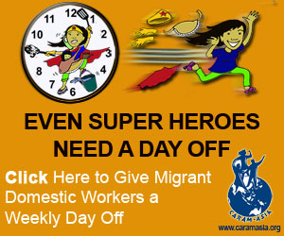
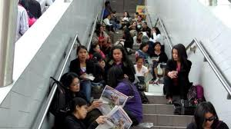
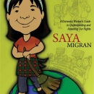
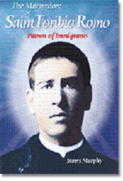
CREATIVE RESISTANCE
Multifaceted: local and global, communal and individual, formal and informal, public and private, as well as religious, cultural, political, economic, etc.
Creative and imaginative: folktales, jokes, songs, rituals, codes, etc.
Strategic Acts: change in names, transformation of marginal(ized) places
Notes:
Saya Migran is a domestic worker's guide to understanding and asserting our rights. Saya Migran personifies the campaign for the recognition of domestic work as work. This comics is a project to raise awareness and educate every migrant worker on the various rights of our sector.

Slide 7
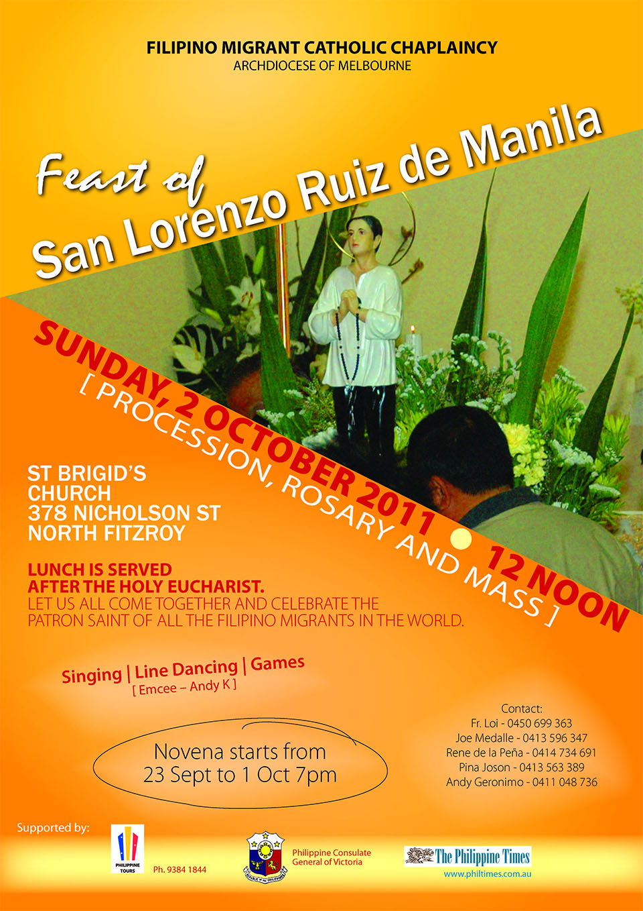
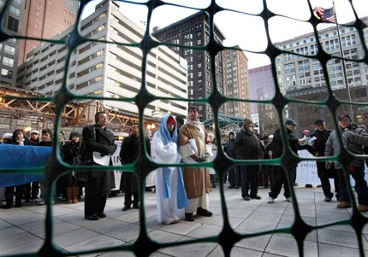
STEADFAST FAITH
91% of the world’s migrants are affiliated with a religion.
49% of the world’s migrants are Christians.
Migration counseling given by priests
Prayer, Eucharist, popular piety
Participation in church activities, e.g. outreach
Keeping their faith in the midst of hardship
Drawing from/engaging their faith in the struggle for justice

Slide 8

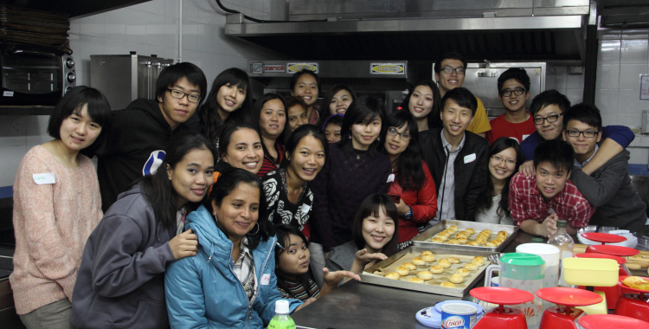

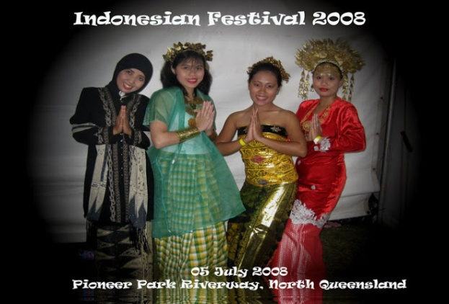

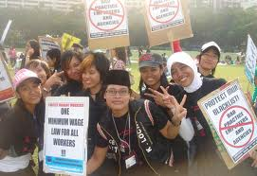

FESTIVE COMMUNITY SPIRIT
Vibrant social circles
A sense of celebration
Centrality of food
Shared meals and festive communal celebrations are potent reminders that Christian life is not just about individual salvation but also about collective liberation and that Christian spirituality
  must not just be about fasting but also about celebrating
  must not just be about families but also about communities.
Notes:
Schutzenfest: festival held in January celebrating German culture in Brisbane and Adelaide
Panyiri: Greek festival held in May in Brisbane

Slide 9
FACETS OF MISSION TODAY
BASED ON MIGRANT SPIRITUALITY

Slide 10
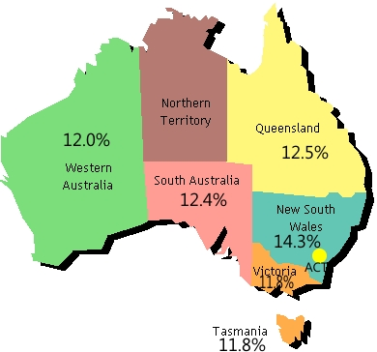
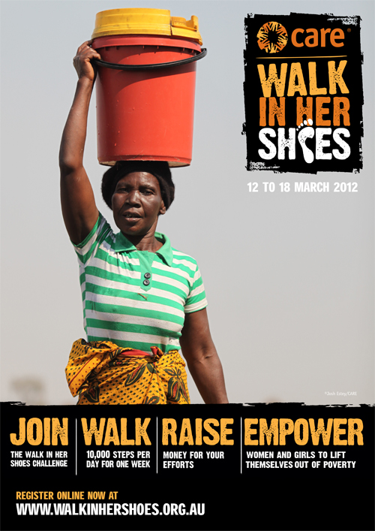
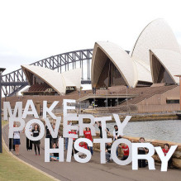
MISSION AMONG ‘CRUCIFIED PEOPLE'
Poverty in Australia
Report 2012
Challenge to “take the crucified people from the cross”
Because and despite of their struggles for justice the crucified people also participate in the mission of liberation.
Crucified people’s struggles embody a luminescent faith, hope, and communal solidarity that have helped desperate communities to survive in the face of overwhelming odds.
www.acoss.org.au

Slide 11
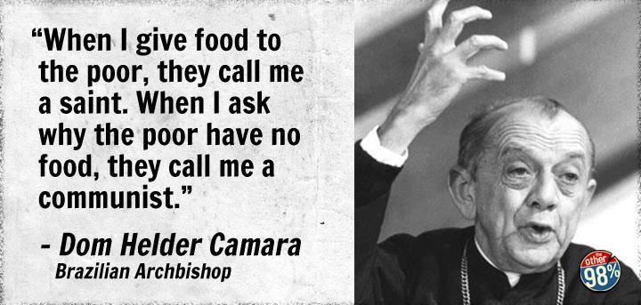
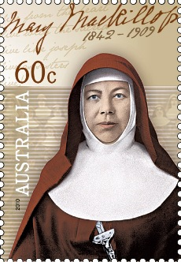

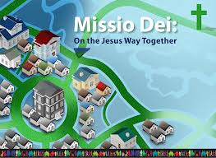

PILGRIMAGE IN THE WILDERNESS
a constant coming and going, continuous departure and arrival, and, like Christian life, a process of continuous transformation.
ethic of risk: ability to name, find, and create other resources that evoke persistent defiance in the face of repeated defeats.
“sheer holy boldness”: deciding to care and act although there are no guarantees of success
God never abandons us in the wilderness.
Mission as missio Dei
www.ndnu.edu

Slide 12

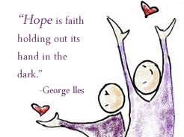
CONSISTENT ETHIC OF HOPE AND LIFE
Looks beyond self-regarding satisfactions to the transcendent values that alone can nourish life and give it direction.
Patiently open to what is, and must be, “otherwise.” It cannot rest except in the truly meaningful and the genuinely good.
Rooted in prayer, a sense of community, and a joyful spirit.

Slide 13
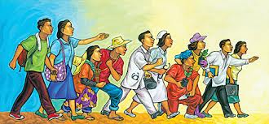
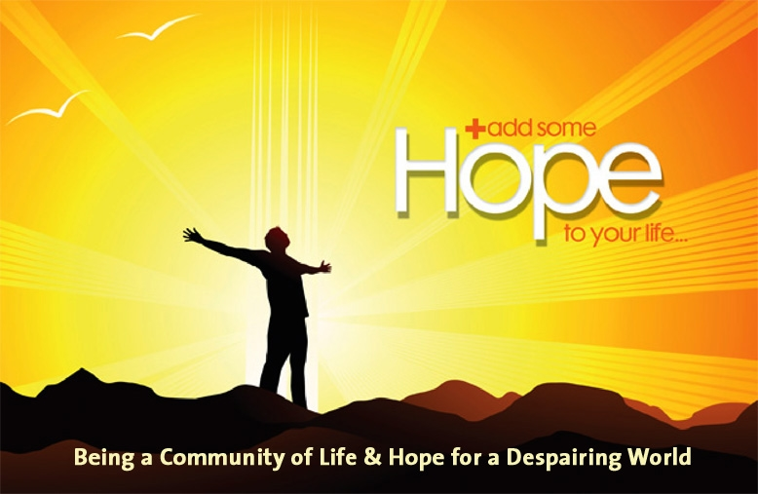
PILGRIMS OF HOPE
In God’s great economy of salvation hope, not death, is the last word.
Nurturing hope per excellence: Persistently believing and witnessing to the reality that in the midst of pain and sin it is possible to discover God’s abundant grace in unexpected and amazing ways.
Mission insists that life is bigger than death; that love is greater than hatred; that goodness is far deeper than evil.

Slide 14
THE END
Gemma Tulud Cruz, Ph.D
Australian Catholic University
Gemma.Cruz@acu.edu.au

